Slide 1
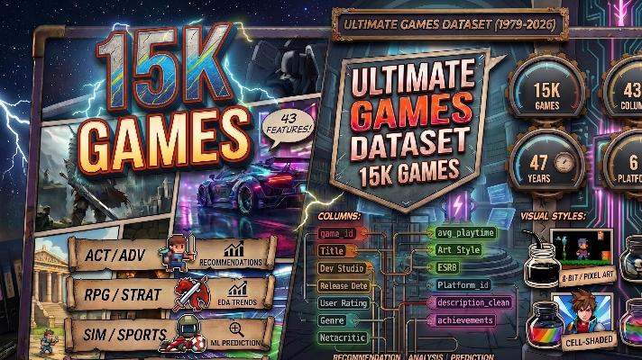
Ultimate Games Dataset
By: Ryan Fitzgerald & Melissa Weitekamp

Slide 2
Kaggle Ultimate Games Dataset Description
https://www.kaggle.com/datasets/rudrakumargupta/ultimate-games-dataset-15k-games-43-features
Dataset of 15,000 video games spanning 1979 to 2026. Covered everything from ratings and playtime to platforms, genres, art styles, and store availability.
Core game metadata was collected via the RAWG Video Games API (rawg.io), which aggregates data from Steam, Metacritic, PlayStation Store, Xbox Store, Epic Games, GOG, and Nintendo Store.
Additional features including theme, art_style, view_dimension, game_mode, popularity_score, engagement_score, rating_tier, metacritic_tier, decade, and is_multi_platform were derived and engineered independently by the author’s data processing and cleaning.

Slide 3
Column Groups & Names
Identity
serial_no, game_id, title, url_slug, cover_image_url, official_website
Release Info
release_date, release_year, decade
Game Characteristics
all_genres, theme, art_style, view_dimension, game_mode, is_multiplayer, is_multi_platform, controls
Developers & Publishers
developers, publishers
Platforms & Stores
all_platforms, platform_count, available_stores
Ratings & Reviews
user_rating, rating_tier, metacritic, metacritic_tier, ratings_count, reviews_count, esrb_rating
Engagement & Popularity
popularity_score, engagement_score, library_count, avg_playtime_hours, achievements_count, game_series_count
Player Status Tracking
status_owned, status_beaten, status_playing, status_dropped, status_toplay, status_yet
Tags & Description
all_tags, description_clean

Slide 4
Analysis Goal
What genre has the most average hours played?
Do games with higher platform counts have higher completion status?
Do multiplayer, singleplayer, or single & multiplayer games have higher metacritic scores?
What decades had the highest rated games?
What was the shift in game’s genres and themes over the decades?
Predict user ratings of games based on metadata

Slide 5
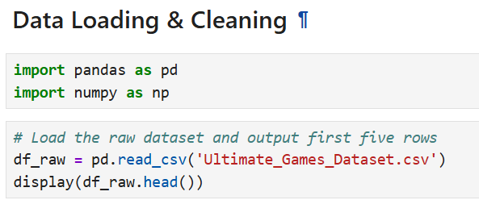
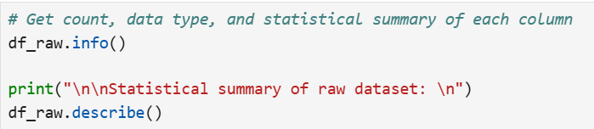
Data Loading & Cleaning
Import the dataset then display the first 5 rows.
Then get more info on each of the columns, such as count and statistical summaries of each column

Slide 6
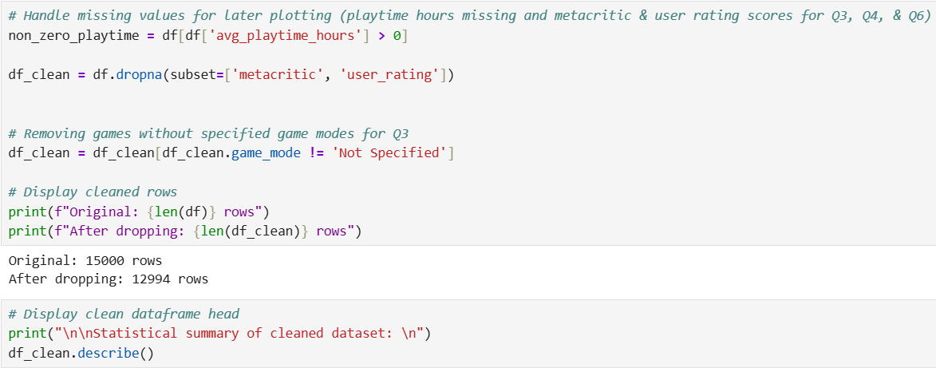
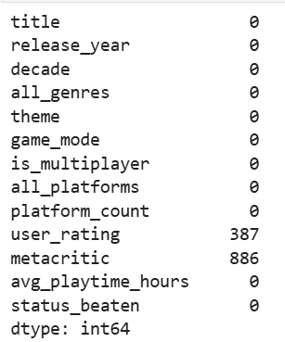
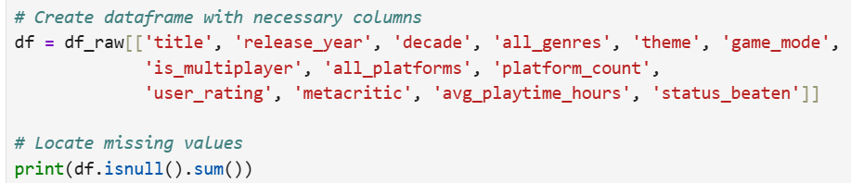
Data Loading & Cleaning Cont.
Create a new dataset with necessary columns
Locate missing values, then handle them
  Unavailable playtime hours, user ratings, and Metacritic scores

Slide 7
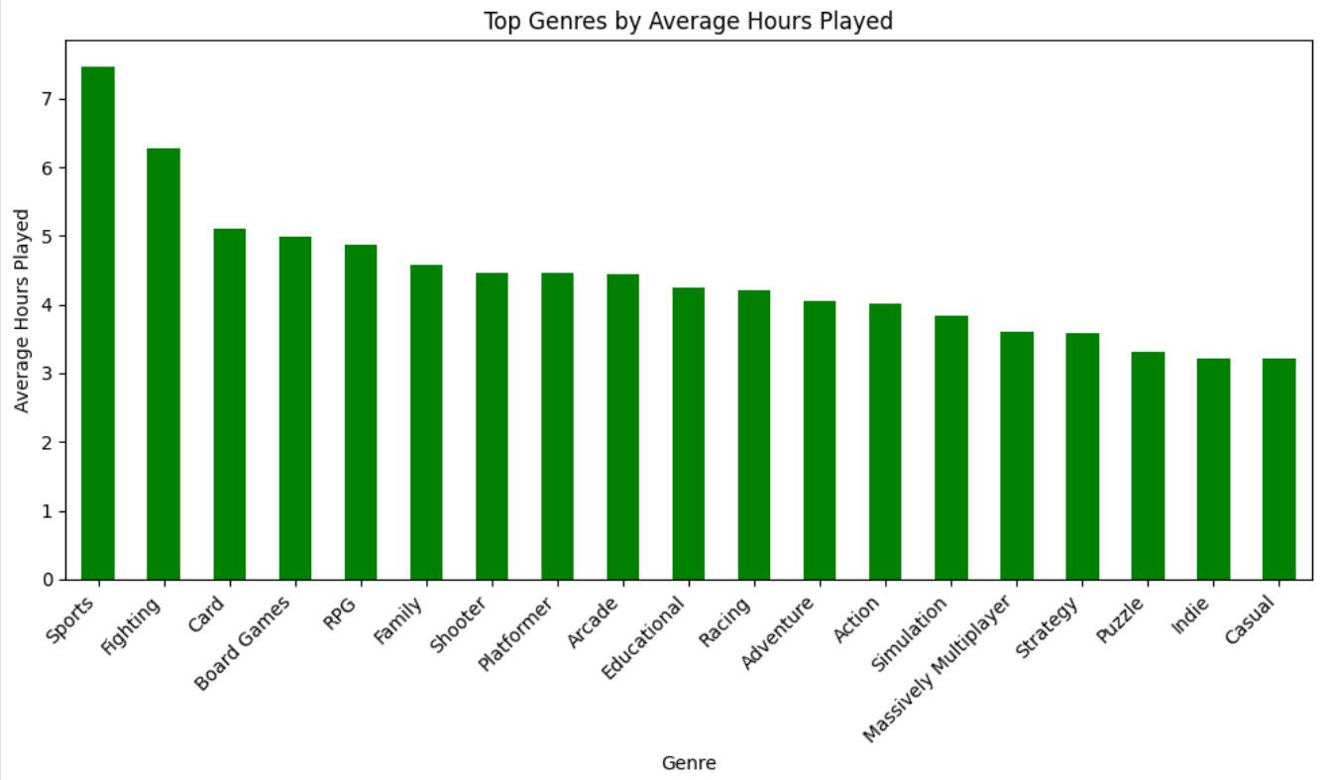
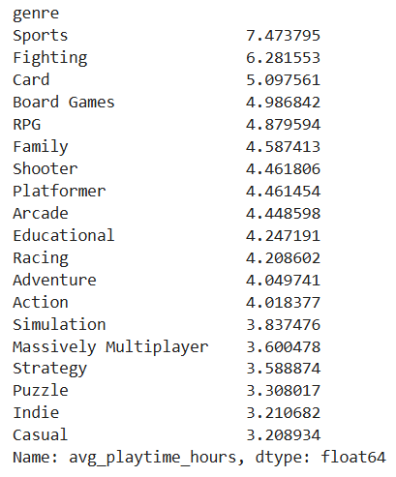
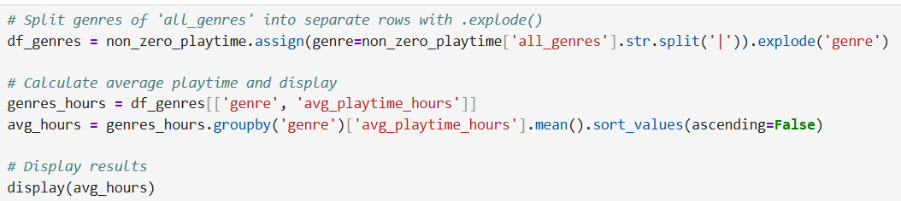
Question 1: What genre has the most average hours played
Sport games have the most average hours (7.47 hours on average)
Fighting is 2nd with 6.28 hours
Casual games have the least average amount (3.21 hours)

Slide 8
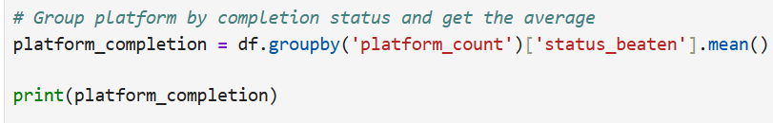
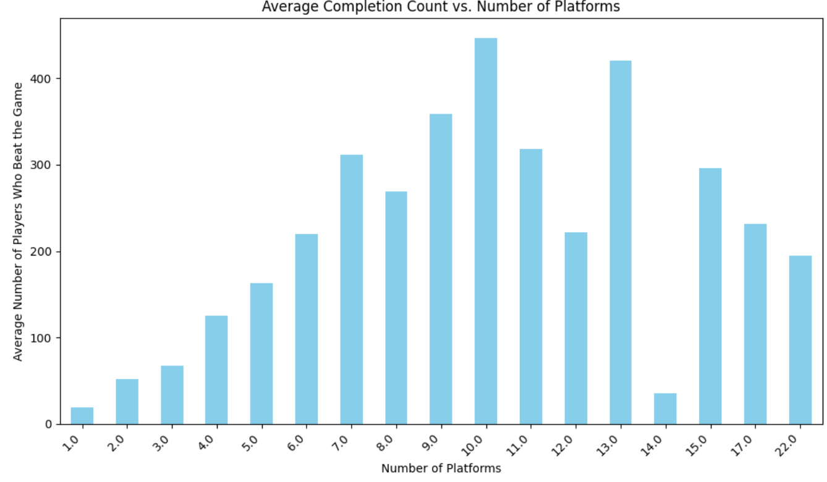
Question 2: Do games with higher platform counts have higher completion status?
On average, the more platform releases a game has, the more likely the game will be played and beaten (positive trend)

Slide 9
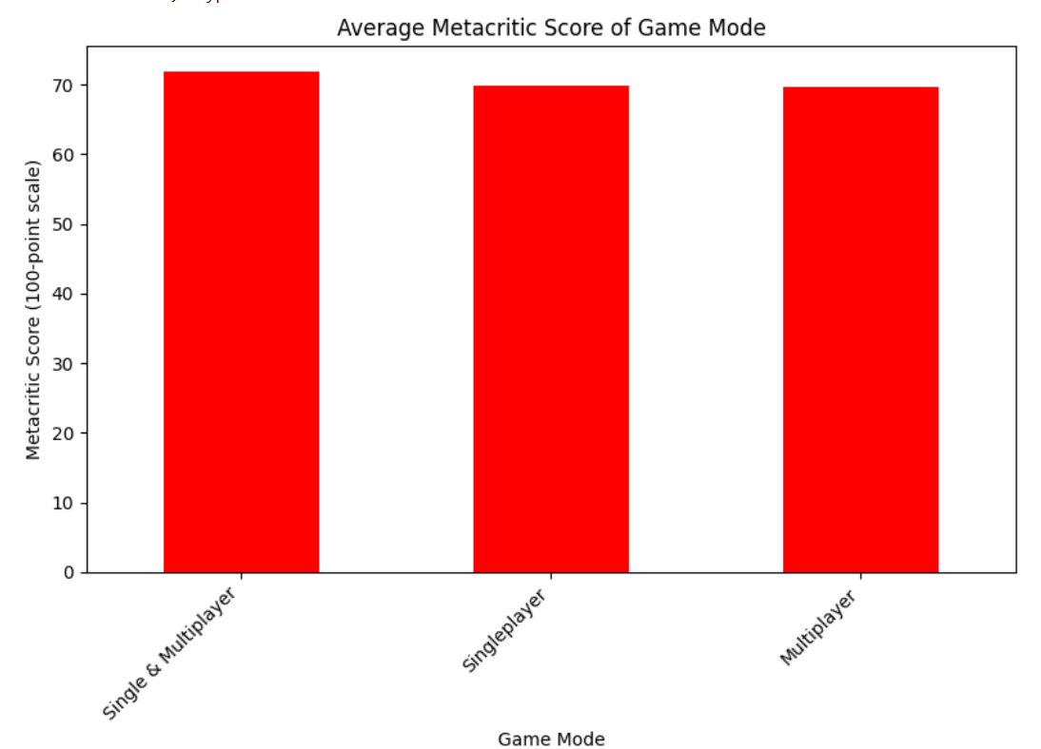
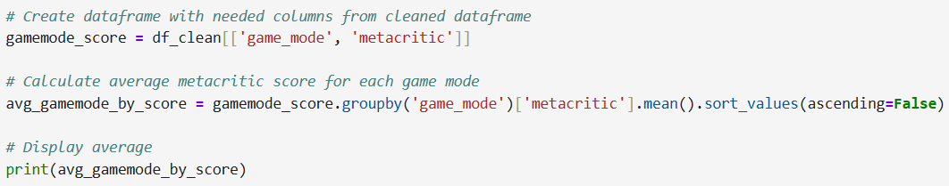
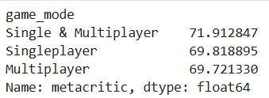
Question 3: Do multiplayer, singleplayer, or single & multiplayer games have higher Metacritic scores?
Not really, the scores are close in range for all three game mode types.
Games that have both game modes do have a slightly higher score.

Slide 10
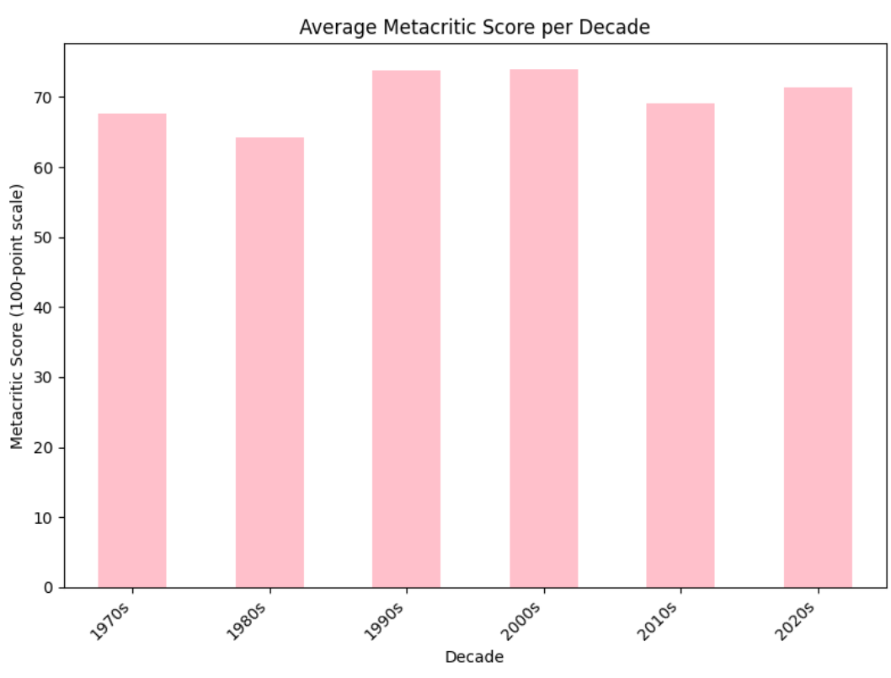
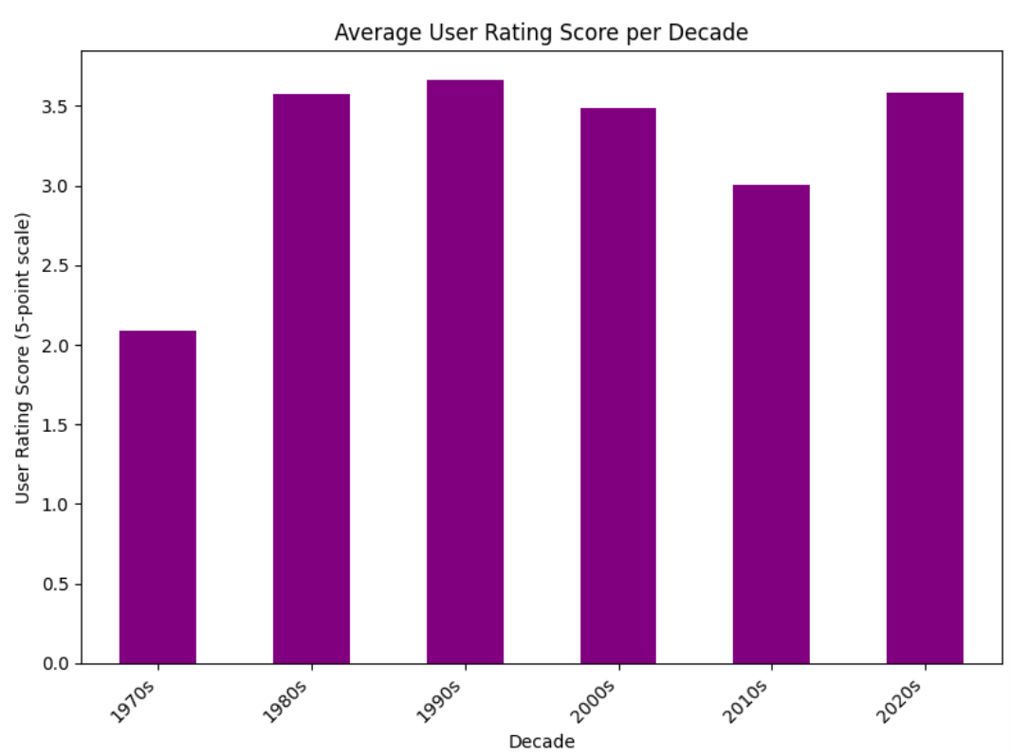
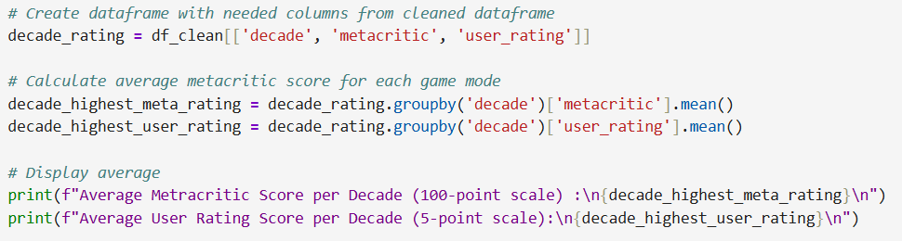
Question 4: What decades had the highest rated games?
The 2000s had the highest Metacritic rating games on average with 1990s close in score.
The 2020s are close in critical reception for Metacritic scoring average
The 1990s had the highest average user rating for games, with 1980s in 2nd, and 2000s in 3rd.

Slide 11
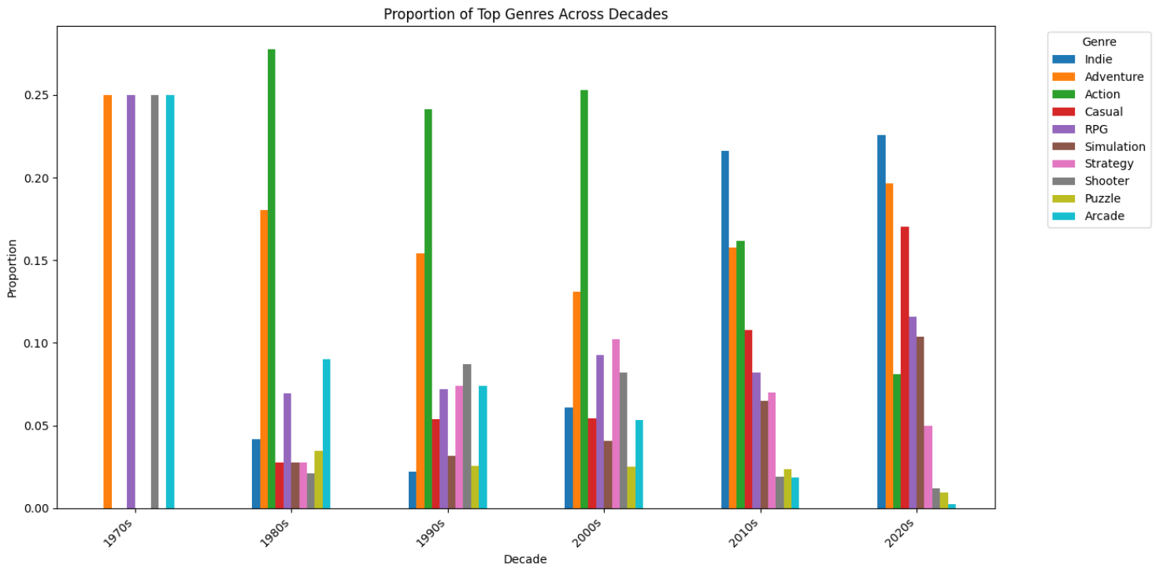
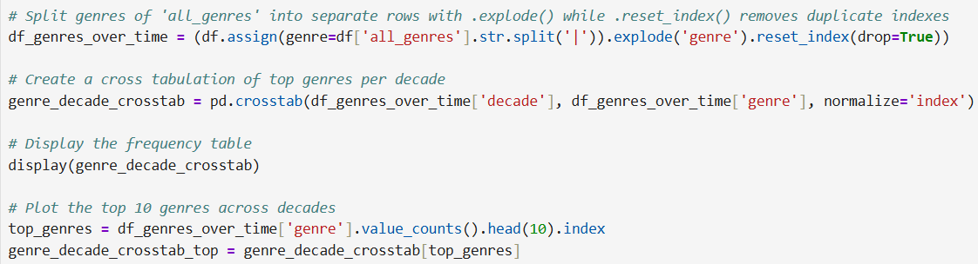
Question 5-1: What was the shift in game’s genres over the decades?
The 1970s had an even mix of Adventure, RPG, Shooter, and Arcade games
The 1980s had a big rise in Action based games and it stayed till the 2000s
By 2010s, there was a rise in Indie games. Adventure and Action games were behind it.
The 2020s had a steady proportion of indie games overall alongside Adventure. Casual games rose this decade.

Slide 12
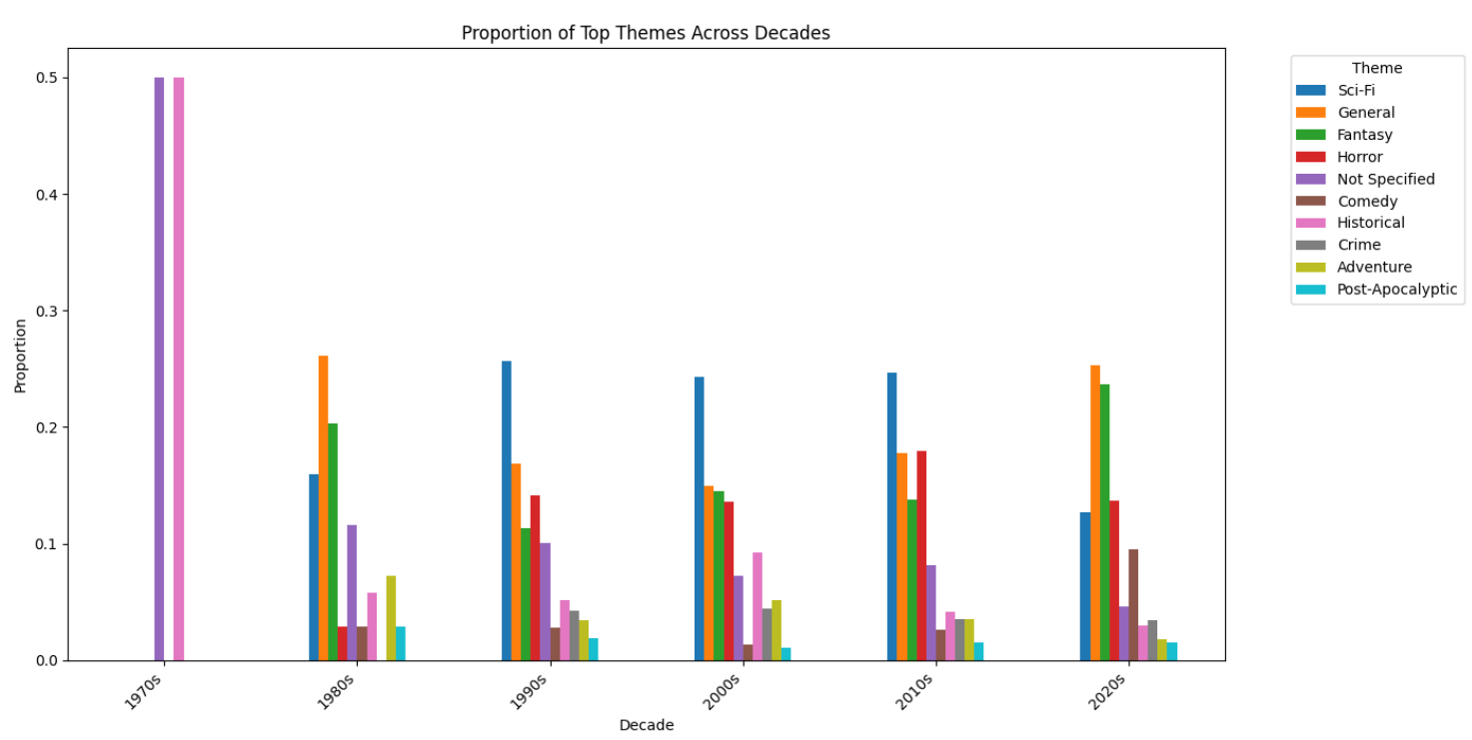
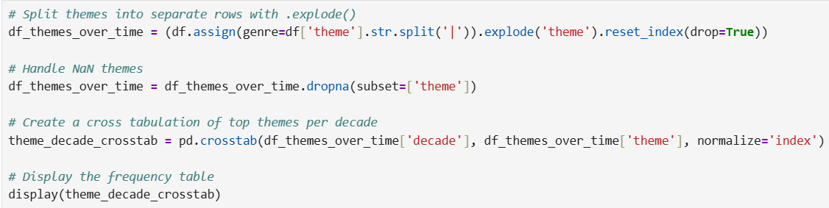
Question 5-2: What was the shift in game’s themes over the decades?
The 1970s themes were evenly Not Specified or Historical
The 1980s had a rise in General and Fantasy themes
The 1990s had a rise in Sci-Fi themed games.
The 1990s and 2000s had a similar proportion of themes to 1980s. Fantasy games steady rose over the two decades.
By 2010s, Horror and General themed games increased in proportion, but Sci-Fi was still the top theme.
The 2020s had a decrease in Sci-Fi. General and Fantasy were the top themes with Horror behind it.

Slide 13
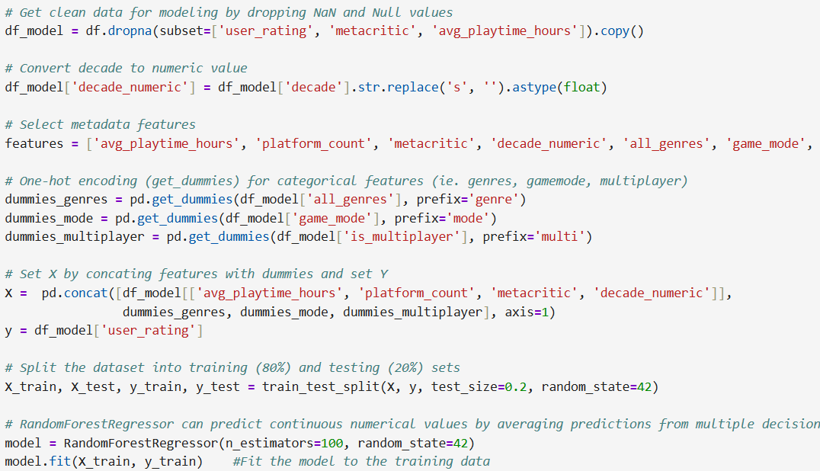
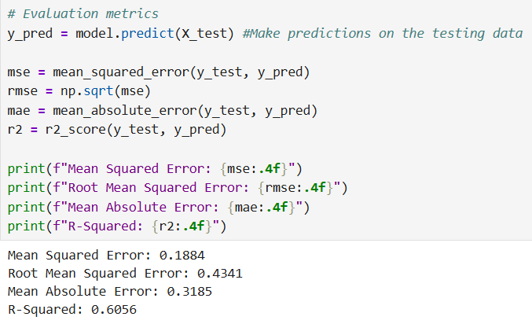
Question 6: Predict user ratings of games based on metadata
RMSE (Root Mean Squared Error) has a larger value than MSE, so there are some outliers but nothing concerning.
MAE (Mean Absolute Error) is relatively low, indicating an accurate model with the absolute differences between forecasted and actual values being close.
R-Sqaure is 0.6056, or 60.56%. R-Squared represents how well independent variables predict the dependent variable; it's larger value indicts an accurate model.

Slide 14
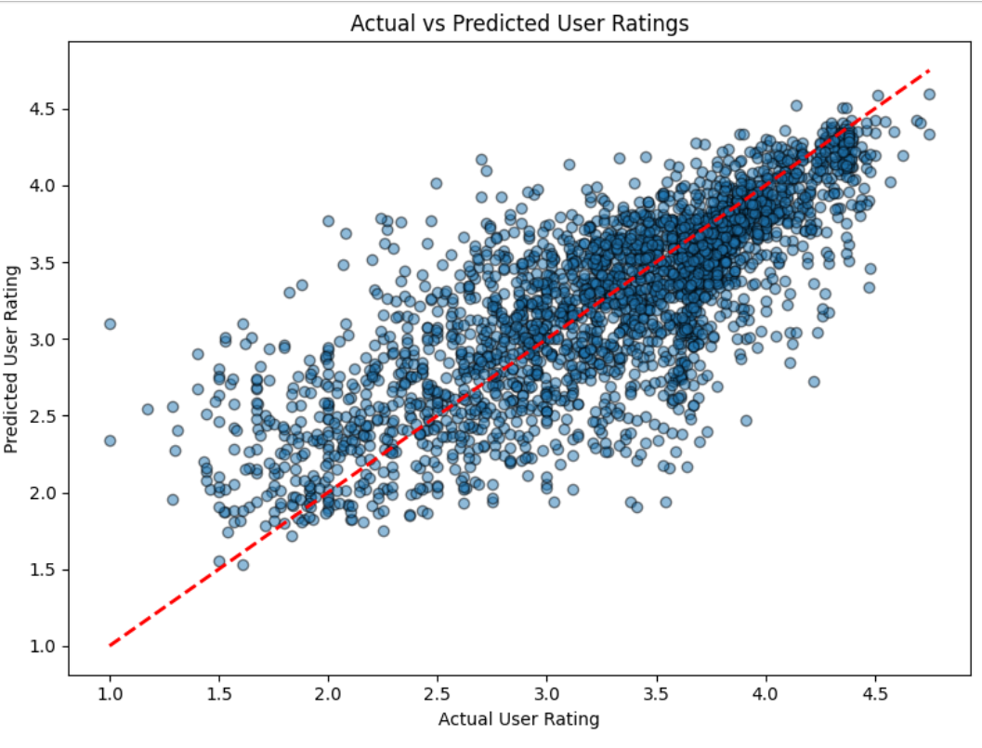
User Rating Prediction ScatterPlot
Shows the correlation of user ratings being close to predicted user ratings. The evaluated metrics support the accuracy of the model.

Slide 15
Take Away from Analyzing the Dataset
Analyzing this dataset showed how certain game characteristics affect engagement with players (Genres).
It also showed how others don’t have much effect on critic ratings (Game Mode)
The 1990s and 2000s had high critical reception while the 1990s and 1980s were more in favor of users’ ratings.
It revealed how the trends and genres of games have shifted over time. Indie and Adventure genres and General and Fantasy themes are the most common ones in our current decade.
Finally, we can predict the likely score of upcoming games based on certain metadata.

